Slide 1

UNIVERSITY OF PETROLEUM & ENERGY STUDIES
School of Computer Science Dehradun
COURSE: Introduction to IT System Security July – December 2023
Delivered
by
Dr. Gopal Singh Rawat
1

Slide 2
Course Plan
Introduction to IT System Security
Operating System Security
Endpoint Security
Application Server Security
Database Server Security
IT System Security Processes

Slide 3
Unit #5: Database Server Security

Slide 4
5.1 What is Data Server:
Refers to the backend system of an Application Server using Client-Server architecture.
Backend → 3rd Tier → Database (from 1st Front end, 2nd Middleware)
Performs tasks → Data Analysis, Storage, Manipulation, Archiving and User requests
User Requests → database Server searches for selected records (data) and passes them back over the network to the user.
Types of Data:
Data can be facts related to any objects:
Name, Age, Height, Weight – medial data related to you.
Picture, Image, Scanned Educational Certificates (PDF files) – uploaded to University portal during admission.
Online Telephone Directory
Bank, Electricity, Water (Government/Service portals) → login, Billing, Retrieve specific information
Facebook – Store (photos/updates/likes) and Retrieve data related to members, friends, activities, messages, ads
Database servers are storage systems having a collection of information.
To manage Database → Database Management Systems (DBMS) →
Centralized → Data is stored in one single location – server, hosting site
Decentralized →Data stored in multiple locations – servers or different sites

Slide 5



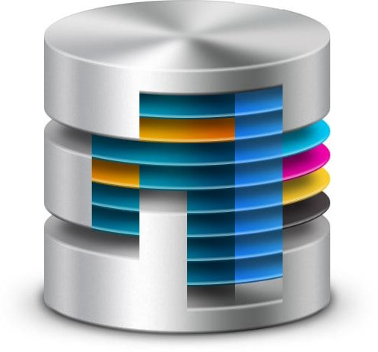


Database
stores information
Information is uploaded (Submit) by users for other people to access (Retrieve) Input methods →
Web portals / Sites → login to Applications Servers → Form → Submit
Use Client-Server Applications (SQL Server-Client)
Sometimes – Data either becomes unavailable to access OR gets into wrong hands (Hackers)
This is where Database Security comes in.
Data goes IN
Data goes OUT

Slide 6
5.2 Types of Data Security Issues:
Unavailable to access
Cyber Attacks → Denial of Service
Hacked → input Corrupt data – Invalid Input allowed by Applications → OWASP Top10 Issue
Inappropriate Access → Stealing - Data Theft (Personal Identifiable Information → PII) Mobile# Birth Dates PAN/Adhaar Card# Driver’s License Information (Bank Accounts details) Home Address
Credit Card info Financial
Database vulnerabilities
Bad Installations - Deployment Failures, Stale accounts/password
Broken databases - Vulnerabilities exploited due to unpatched OS/DB
Data leaks – at transit or application programs, encryption
Stolen database backups (Tapes, Disks)
Lack of segregation – duties, access, views
Hopscotch – find way initially in network → server → application system → user → reach backend database server
SQL injections – unclean variables, codes inserted into input strings and passed to a DB for execution
Bad Encryption Keys Management
Trojan Horse
Missing – Standards, Good practices, Compliance procedures

Slide 7
5.3 Aim of Database Security →
Ensure how to block others from accessing private information or attacks, theft, data corruption
#1 Software Controls: ensure that people can’t gain access to the database through viruses, hacking, or any similar process
Confidential (secrecy): Data must not ever be presented to any individual who does not have legal access to it
Authentication (accuracy, integrity): information can't be changed malignantly or adulterated deliberately
Authorization: credential level/groups to access data
Recoverable (availability): system should continue running, data may be recouped easily, effectively for accessibility
#2 Physical Controls: Locks/Room Access restrictions/Secure location or even constant monitoring of the database server
#3 Administrative Controls: Use of Passwords, Restricting access of certain people to certain parts of the database, or blocking the access of some company personnel altogether.
#4 Data Masking: hide or remove portions of data

Slide 8
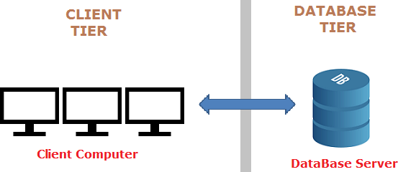
5.4 Database Architecture
a.) 2-Tier Database Management System
ODBC

Slide 9
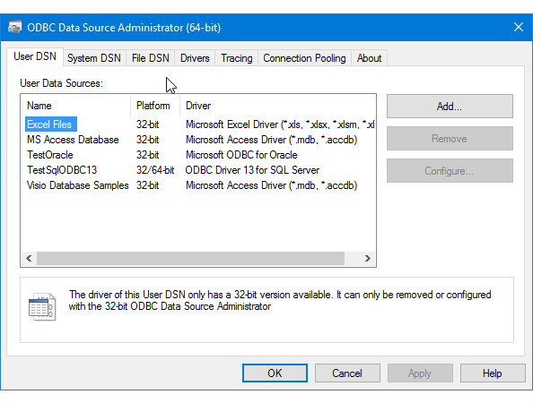
5.4 Database Architecture
a.) 2-Tier Database Management System ODBC = Open DataBase Connectivity
Allows client side requests program requests to talk to the database
OS have built-in drivers allow OS → Database connectivity
Adds layer of security – user authentication
Client – Server application (SQL Server) – Railway / Bank branches
Useful for small volume of data processing – direct access to server

Slide 10
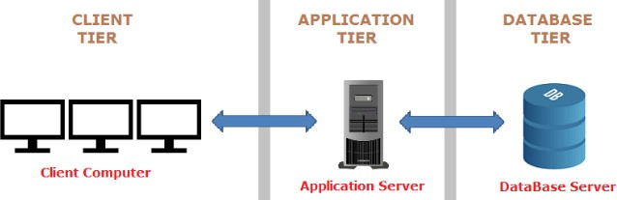


5.4 Database Architecture
b.) 3-Tier Database Management System
Presentation Layer
Application Layer
Database Layer
GUI Web Page
Database Farms
Business Logic
Mostly used by Web based Application Systems
Complex, Independent, Scalable, Handle huge User requests, Add Different Applications

Slide 11
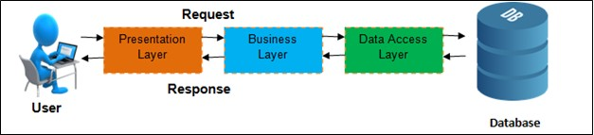
5.4 Database Architecture
b.) 3-Tier Database Management System
Mostly used by Web based Application Systems
Complex, Independent, Scalable, Handle huge User requests, Add Different Applications
Notice:
Ecommerce Portals
Allow access via Web Portals
Don’t offer Client-Server Programs

Slide 12
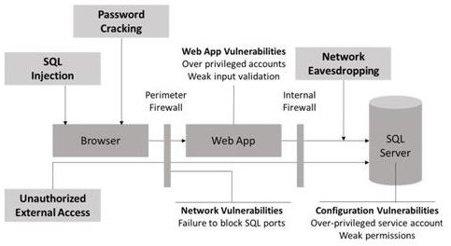
5.5 Database Server threats:
2
5
1
4
3
7
6
Database Server Threats:
Threats on Database lead to attacks like:
SQL Injection
Password Cracking
Unauthorized External Access – physical / logical
Network Eavesdropping – sniffing traffic
Web App Vulnerabilities
Configuration Issues
Network Vulnerabilities – devices / cables
Unauthorized Modification
Unauthorized Disclosure
Loss of Availability → DoS
Commercial losses → Legal & Regulatory issues
Personal Privacy Data Protection
Computer Misuse

Slide 13
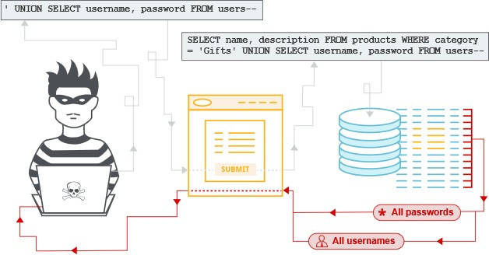
5.5 Database Server threats:
1. SQL Injection (SQLi): manipulate a standard SQL query to exploit non-validated input vulnerabilities in a database
Mitigation (stop SQLi attack)
Validate Input before executing SQL Query
Allow safe SQL parameters for Data Get (1=1)
Restrict data access for SQL Login and requests
Hacker targets
https://www.estore.com
Comes to know products @ /items.asp
Send INPUT query as → https://www.estore.com/items/items.asp?itemid=999 or 1=1 to pull information for a specific product
SQL query on Database → SELECT ItemName, ItemDescription FROM Items WHERE ItemNumber = 999 OR 1=1
Since 1=1 is always true, the query returns names of all the items even for those not eligible to access that particular data
OR Send INPUT query as → https://www.estore.com/items/iteams.asp?itemid=999; DROP TABLE Users
Entire User Database could be deleted (DROP = DELETE)
OR Send INPUT → https://www.estore.com/items/items.asp?itemid=999 UNION SELECT user-name, password FROM USERS
SELECT ItemName, ItemDescription FROM Items WHERE ItemID = '999' UNION SELECT Username, Password FROM Users
Retrieve User name and passwords from database

Slide 14
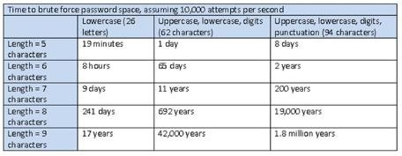
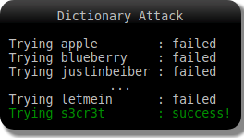
5.5 Database Server threats:
2. Password Cracking:
Issues:
Break regular named users (E.g. SA or Admin or Administrator or SQLDBA)
Weak passwords
Standard Words / Numbers (Abc1234 / Admin1234)
Types of Password Attacks
Dictionary attacks –
Try all words from an exhaustive precompiled list
Dictionary words
Brute Force –
Trial and error method using automated software to generate large number of consecutive guesses
Every possible combination, Time taken is more
Manual speculation – hit and try
Mitigation
Complex password for SQL server.
Avoid common passwords found in dictionary.

Slide 15
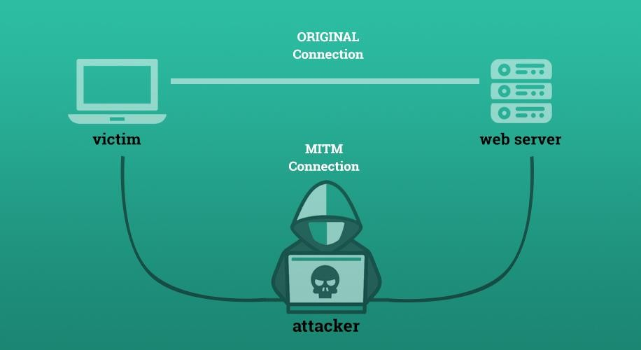
5.5 Database Server threats:
3. Network Eavesdropping:
Issues:
Directly tuning in to computerized or simple voice correspondence
Sniffing or block attempt of information identifying with any system of correspondence – Man in the Middle (MITM)
Mitigation:
Physical security of Data centers, Servers, Network Cables – Access controls, Locks, ID Cards, Two Factor Authentication
Using SQL validation set up of Windows accounts – domain users
Using SQL validation without a server endorsement – restricted access to Database Admins → Privilege Abuse/Elevation

Slide 16
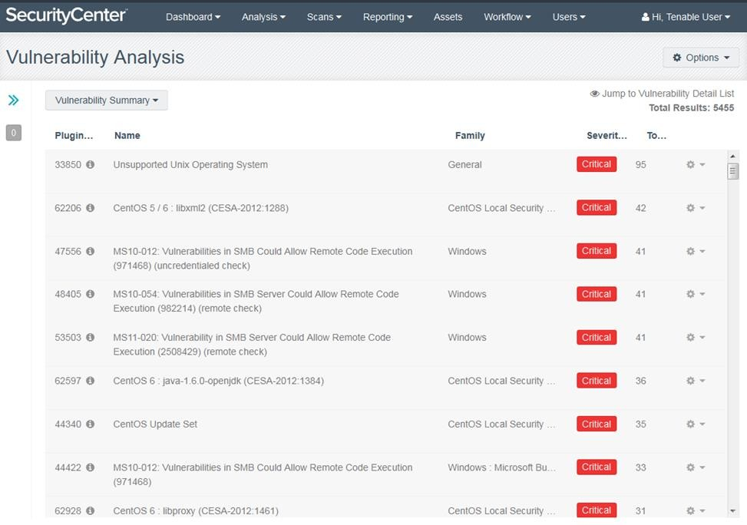
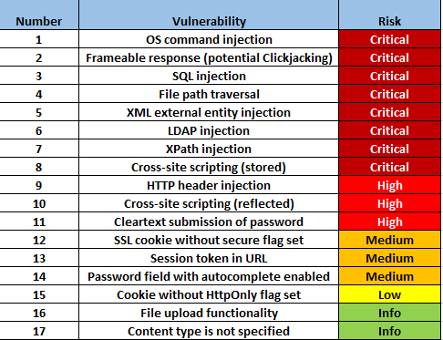
5.5 Database Server threats:
4. Web App Vulnerabilities:
OS and Application level vulnerabilities
Weak Communication Protocol and Data Encryption
E.g. use of Window 98/20000 systems – unpatched
E.g. Run additional services installed on a database server → Illegal access, Denial of service or data Corruption

Slide 17
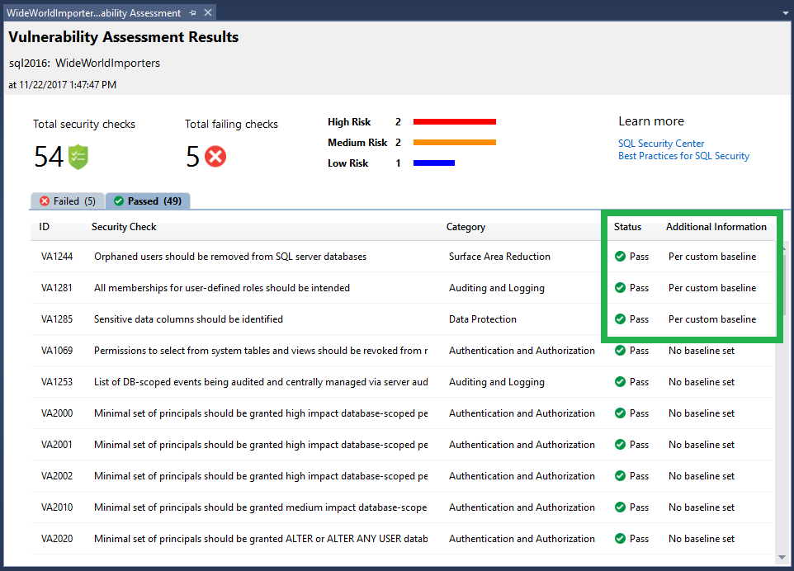
5.5 Database Server threats:
5. Database Configuration Vulnerabilities:
Issues:
Logging Issues → No Audit Trails, No Alerts to Cyber Security Operations teams
Database Security Patches
Use of Non-Standard ports on SQL Server OR Proxy / Web Application Firewall issue
Absence of IPSec or TCP/IP isolating controls
Mitigation :
Remove default config/ Restrict access.
SQL server port not visible from outside.
Limit direct access using IPSec or TCP/IP filters

Slide 18
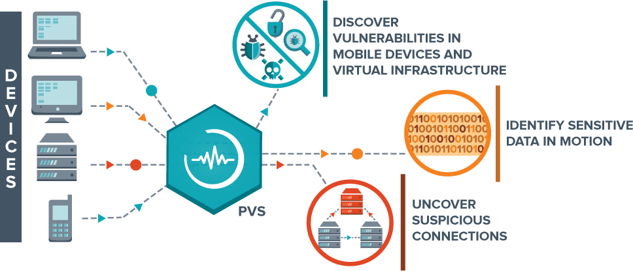
5.5 Database Server threats:
6. Network Vulnerabilities:
Issues:
Using network devices, virtual infrastructure vulnerabilities
Data in Transit
Unauthorized external connections to Database Server
Mitigation :
Server Certificate for database server.
SSL connection between web and DB server.
Encrypted IPSec between web and DB server.

Slide 19
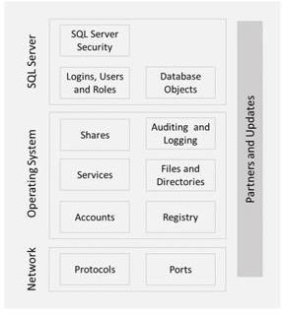
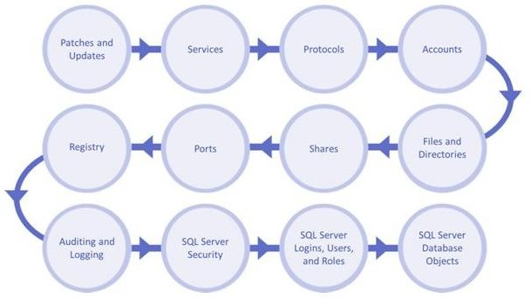
Steps for Securing Database Server

Slide 20
Best Practices to secure Database server
Strong Password Policy Execution
Discard all Default Users and Demo-test Databases
Change the Admin User Name
User Privileges Need to be Restricted
Disable Public Network Access to Database Servers
Enforce SSL/TLS on Remote Connections and Restrict IP
Check for Database Dumps in Public Locations
Encrypt Your Application Files and Backups
Web Application Firewall and Malware Scanner Should be used
Always keep the Software Updated
Open-Source Databases
Berkeley DB
MySQL
CouchDB
MongoDB
MariaDB
SQLite
PostgreSQL
Redis
Neo4j
SAP DB
Cassandra

Slide 21
5.6 Server Security Mechanisms
#1. Network Address Translation (NAT) #2. Port Address Translation (PAT)
#3. Demilitarized Zone (DMZ) #4. Content Based Firewalls #5. SSL Connections
#6. IPSec

Slide 22
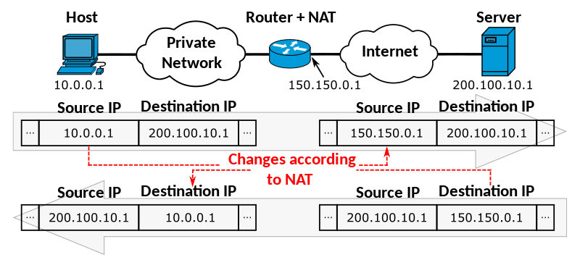
5.6 Server Security Mechanisms
#1. Network Address Translation (NAT)
NAT allows a single device (Router) as an agent between the Internet and a local network (or private network)
Only a single unique IP address is required to represent an entire group of computers to anything outside their network
Normally used for browsing from inside network
Notes:
Total port: 65535

Slide 23
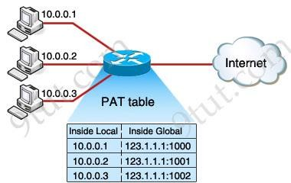
5.6 Server Security Mechanisms
#2. Port Address Translation (PAT)
Extension to NAT, Helps conserve Public IP Addresses
Permits multiple devices on LAN to be mapped to a single public IP address with different ports
123.1.1.1 → Email Server (port 995), FTP server (port 21), Host applications (8080, 8081, 8082, 443, 80)

Slide 24
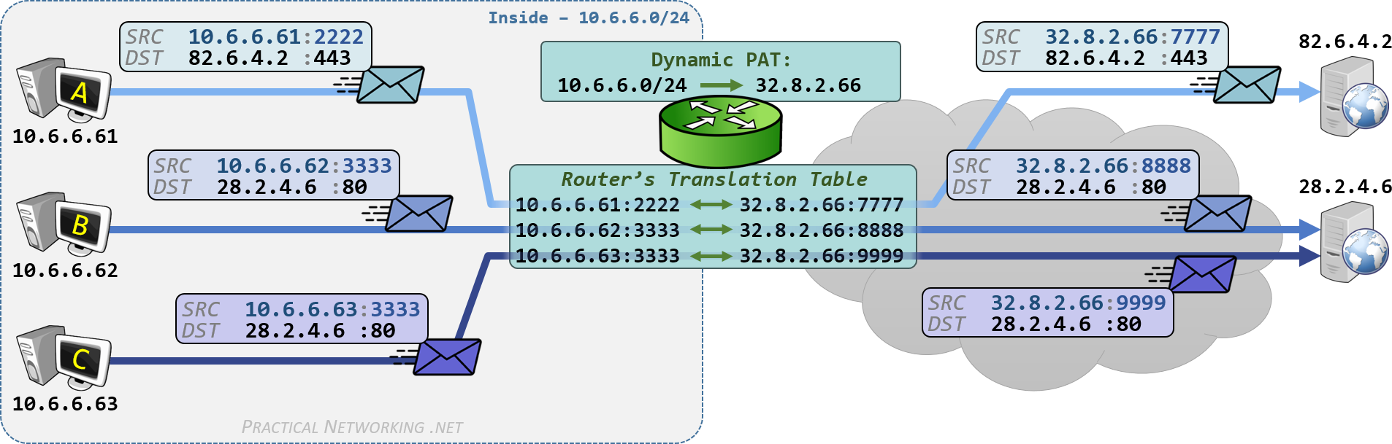

Slide 25
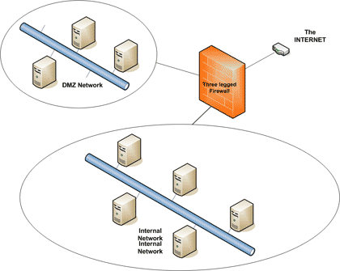
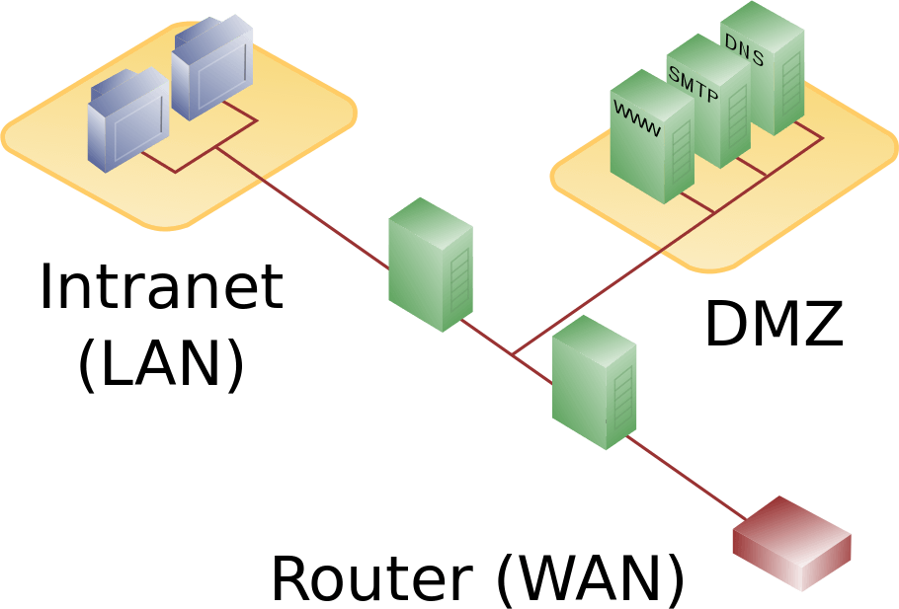
5.6 Server Security Mechanisms
#3. Demilitarized Zone (DMZ)
Perimeter network or screened subnet
Physical and logical subnetwork, away from office network
Exposes an organization's external-facing services to untrusted Internet
Host Front end Web Pages for organization’s Applications, Email, FTP, Honeypots (to detect hacker’s behaviors)

Slide 26
5.6 Server Security Mechanisms
#4. Content-based Firewalls
Recent Firewall Technology feature, has capacity to investigate & inspect data packets (incoming & outgoing records)
For incoming traffic →
content filtering is after crossing the firewall access control component, and before permitted traffic is sent to the internal users
For outgoing traffic →
content filtering is after the firewall access control component, and before permitted traffic is sent to external network.
Equipped for perusing SQL inquiries, Question information, Approval information, XML information
Can restrict who can Open, Email, Print or Edit a piece of content
Can help in placing a time limit on how long a user can access a given piece of content
Content can expire from a given repository and no longer be viewable by anyone

Slide 27
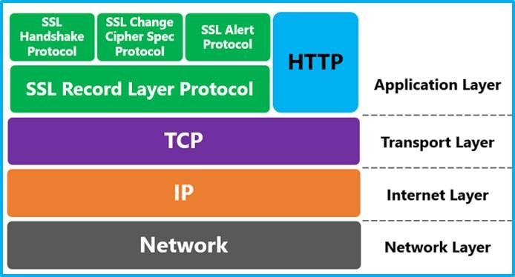
5.6 Server Security Mechanisms
#5. SSL connections
SSL is generally used to secure Web-server associations with programs & end users
This can be utilized for connections between the Front end systems & Backend Database Server
SSL utilizes individual Key Cryptography and the Shared Key to encode all associations
Can lead to significant impact on data retrieval/delivery of information exchange → Reduces man-in-the-center assaults.

Slide 28
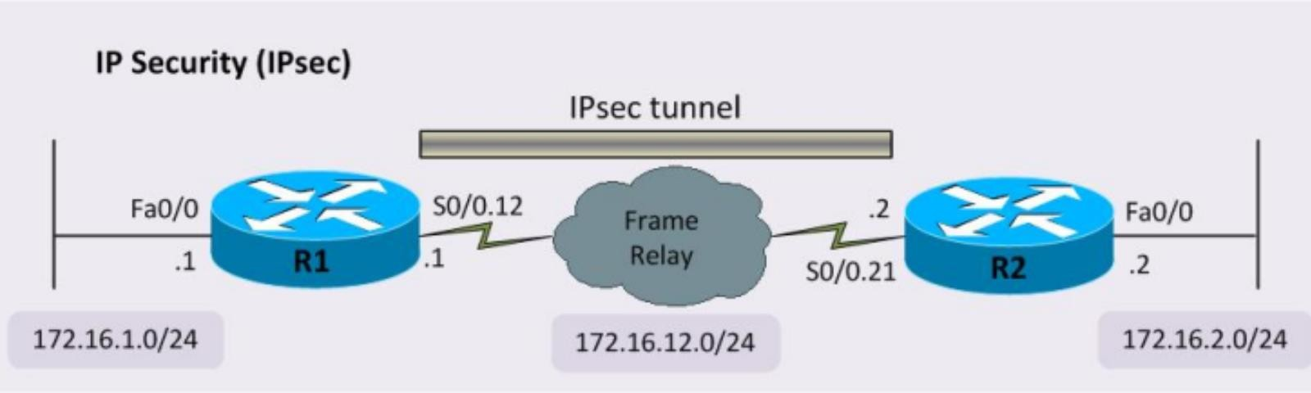
5.6 Server Security Mechanisms
#6. IPSec (IP Security)
Set of protocols that provides security for Internet Protocol (IP) @ Network Layer.
Use cryptography to provide security
Used for the setting up of virtual private networks (VPNs) in a secure manner
Modes of operation:
Transport Mode: Protects Information from Transport Layer, Does not protect IP Header Information
Tunnel Mode: Protects original IP Header

